Slide 1
MNIST DIGIT
RECOGNITION
Handwritten digit classification using deep learning
Presented by: YASH RANA | Course: ARTIFICIAL INTELLIGENCE

Slide 2
Project Overview
MNIST Handwritten Digit Recognition
• Recognize handwritten digits from 0 to 9.
• Use the MNIST image dataset.
• Train and evaluate a neural-network model.
• Save the trained model for future use.
02

Slide 3
Problem & Objectives
MNIST Handwritten Digit Recognition
• Problem: identify the number represented by a handwritten image.
• Prepare image data for machine learning.
• Train a model to classify ten digit categories.
• Evaluate performance and save the model.
03

Slide 4
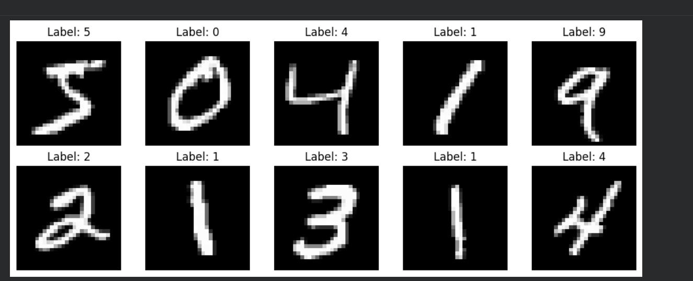
What Is MNIST?
MNIST Handwritten Digit Recognition
• A standard dataset for handwritten digit recognition.
• Grayscale images of 28 × 28 pixels.
• Ten classes: digits 0 through 9.
• Standard split: 60,000 training and 10,000 test images.
04

Slide 5
Tools & Technologies
MNIST Handwritten Digit Recognition
• Python for implementation.
• Google Colab / Jupyter Notebook for running code.
• TensorFlow / Keras for model training, if used.
• NumPy / Matplotlib for data handling and plots, if used.
• GitHub for sharing project files.
05

Slide 6
Project Workflow
MNIST Handwritten Digit Recognition
• 1. Load images and labels.
• 2. Normalize pixels and prepare image dimensions.
• 3. Build the neural-network architecture.
• 4. Train on labeled images.
• 5. Evaluate on test data.
• 6. Save the trained model.
06

Slide 7
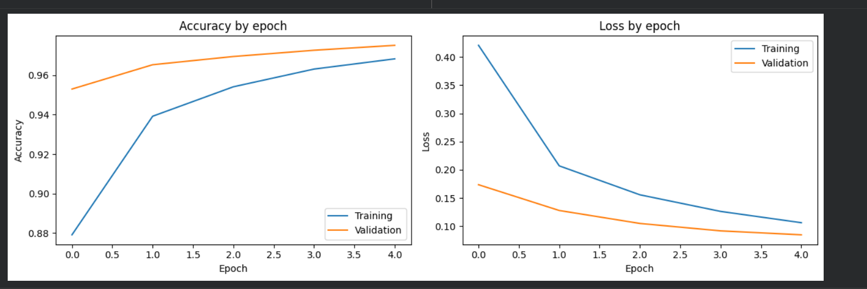
Model Training
MNIST Handwritten Digit Recognition
• The model learns patterns from labeled digit images.
• Training adjusts parameters to reduce classification errors.
• Test data estimates performance on unseen examples.
• Use the exact architecture and settings from your notebook.
07

Slide 8
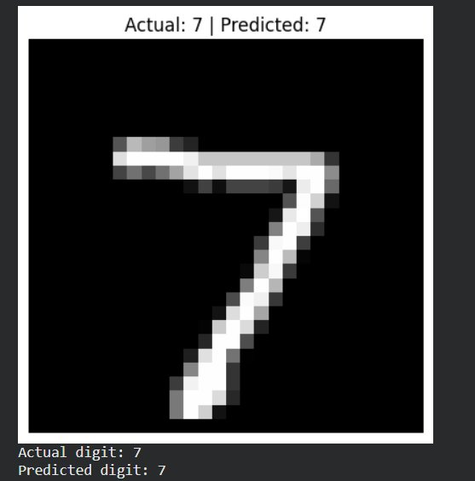
Results & Output
MNIST Handwritten Digit Recognition
• Notebook reached the model-saving completion step.
• Saved model: models/mnist_digit_model.keras.
• Add the exact test accuracy printed by your notebook.
• Insert a screenshot of training results or sample predictions.
08

Slide 9
Applications
MNIST Handwritten Digit Recognition
• Reading handwritten numbers on forms.
• Digit recognition in document processing.
• Educational demonstrations of image classification.
• Foundation for more advanced computer vision.
09

Slide 10
Limitations & Future Scope
MNIST Handwritten Digit Recognition
• Performance may drop on photos or images unlike MNIST.
• Input images need correct resizing and normalization.
• Build a drawing interface for users to enter digits.
• Compare a basic network with a convolutional neural network (CNN).
10

Slide 11
Conclusion
MNIST Handwritten Digit Recognition
• Demonstrates a full introductory deep-learning workflow.
• Covers preprocessing, training, evaluation, and saving.
• Provides a foundation for computer-vision projects.
• Thank you
11

